Slide 1


Diabetes Prediction Analysis
Viz Wizards – Uncovering Diabetes Risks with Data
By
Sadia - 50398627
Nimisha - 50602756
Saumya - 50603672
Vaishnavi - 50590668
explored a dataset to uncover key risk factors and trends associated with diabetes. This presentation summarizes our findings and insights

Slide 2

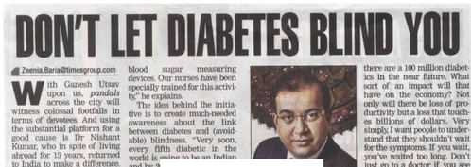

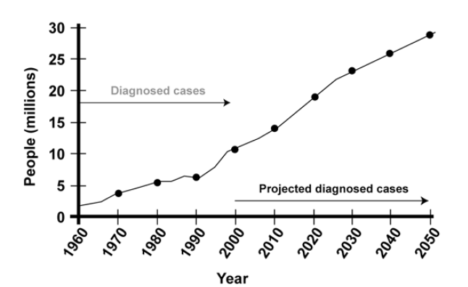

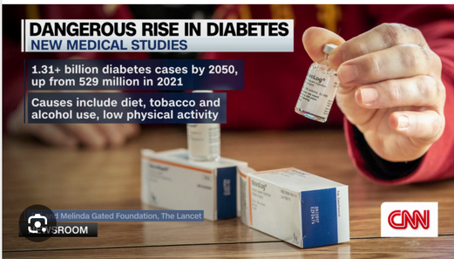
Alarming Rise in Diabetes – What the Headlines Are Telling Us

Slide 3
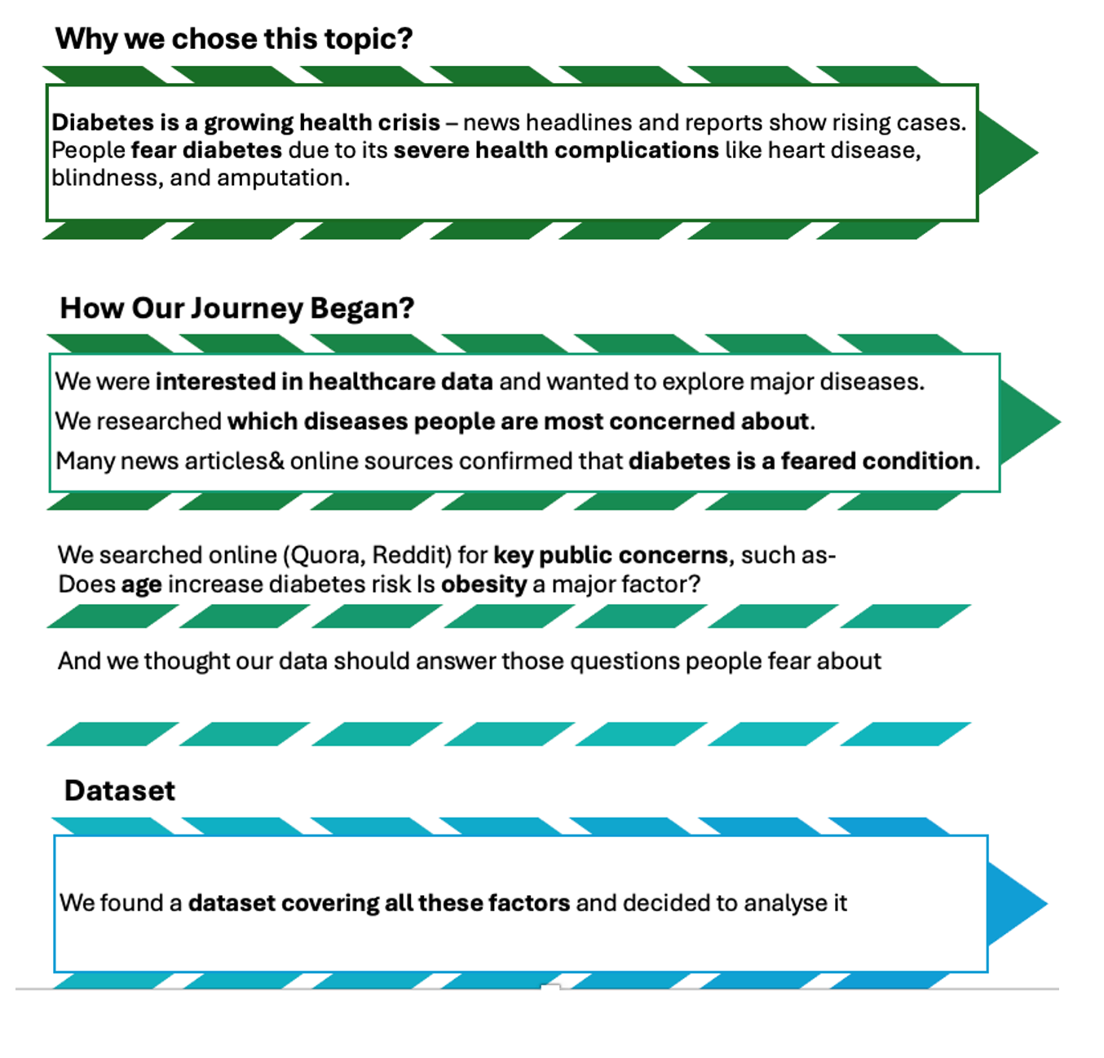


Slide 4

INSIGHTS

Slide 5
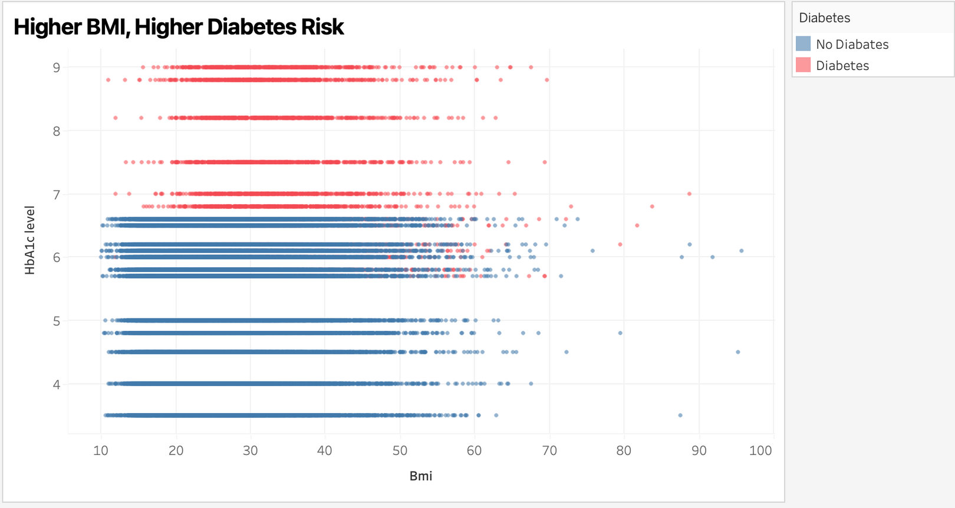


Higher BMI, Higher Blood Sugar – Is There a Diabetes Pattern?
Most diabetics have higher blood sugar levels (HbA1c > 7), regardless of BMI
Non-diabetics mostly have lower blood sugar levels (HbA1c < 6), even at higher BMIs
Higher BMI increases the likelihood of diabetes

Slide 6



Behind the Visual – Why, How & What We Discovered
WHY WE CHOSE THIS VISUAL?
A scatter plot helps show the relationship between BMI and blood sugar (HbA1c) levels)
Color coding (red for diabetics, blue for non-diabetics) makes it easy to spot trends.
CHALLENGES WE FACED
CHOOSING THe right axis scaling for better data visibility
Ensuring key trends are visible despite data variability
ANSWERS KEY QUESTION
DOES OBESITY INCREASE BLOOD SUGAR AND DIABETES RISK?

Slide 7
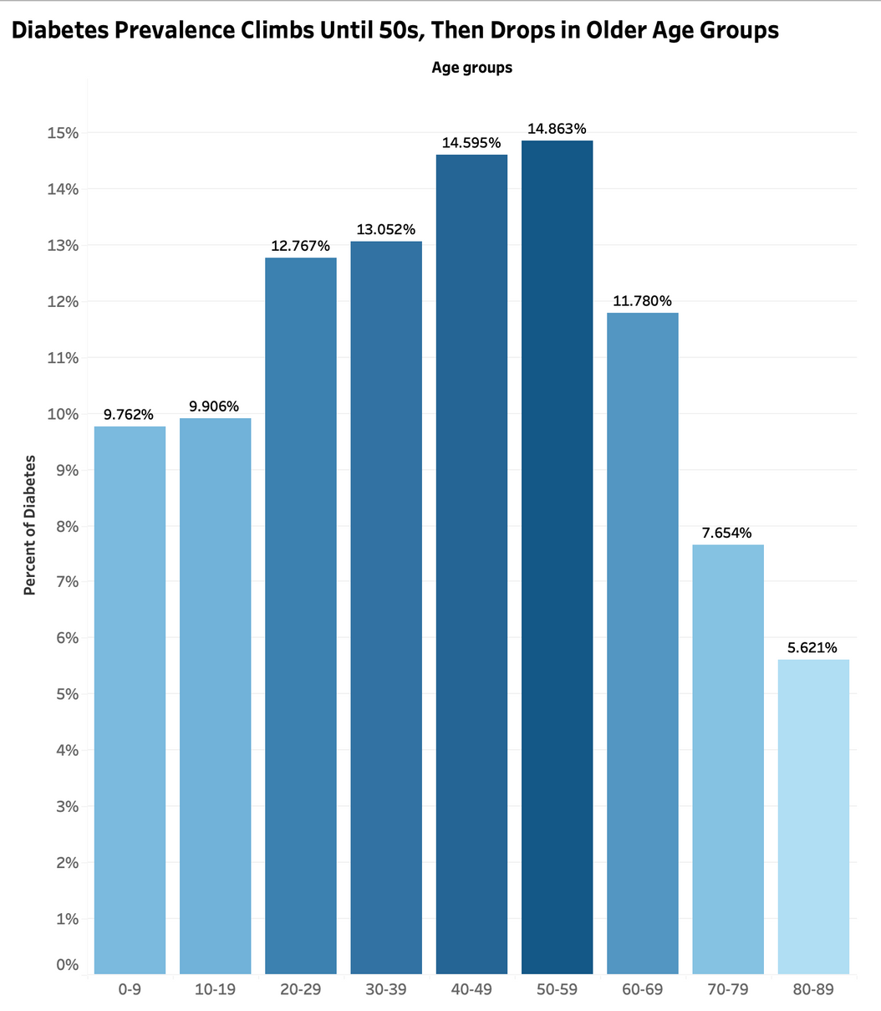
Diabetes Prevalence Peaks in Middle Age – Does Age Play a Role?
Most prevalence amongst middle aged groups
Least prevalent amongst elderly and young individuals

Slide 8
Behind the Visual – Why, How & What We Discovered
WHY WE CHOSE THIS VISUAL?
SIMPLE, CLEAR AND EFFECTIVE
Handles a large amount of data
CHALLENGES WE FACED
DECIDING ON THE TYPE OF CHART TO USE
Making the data pop and easy to understand
ANSWERS KEY QUESTION
DO CERTAIN AGE GROUPS HAVE A PREVALENCE TO DIABETES THAN OTHERS?

Slide 9

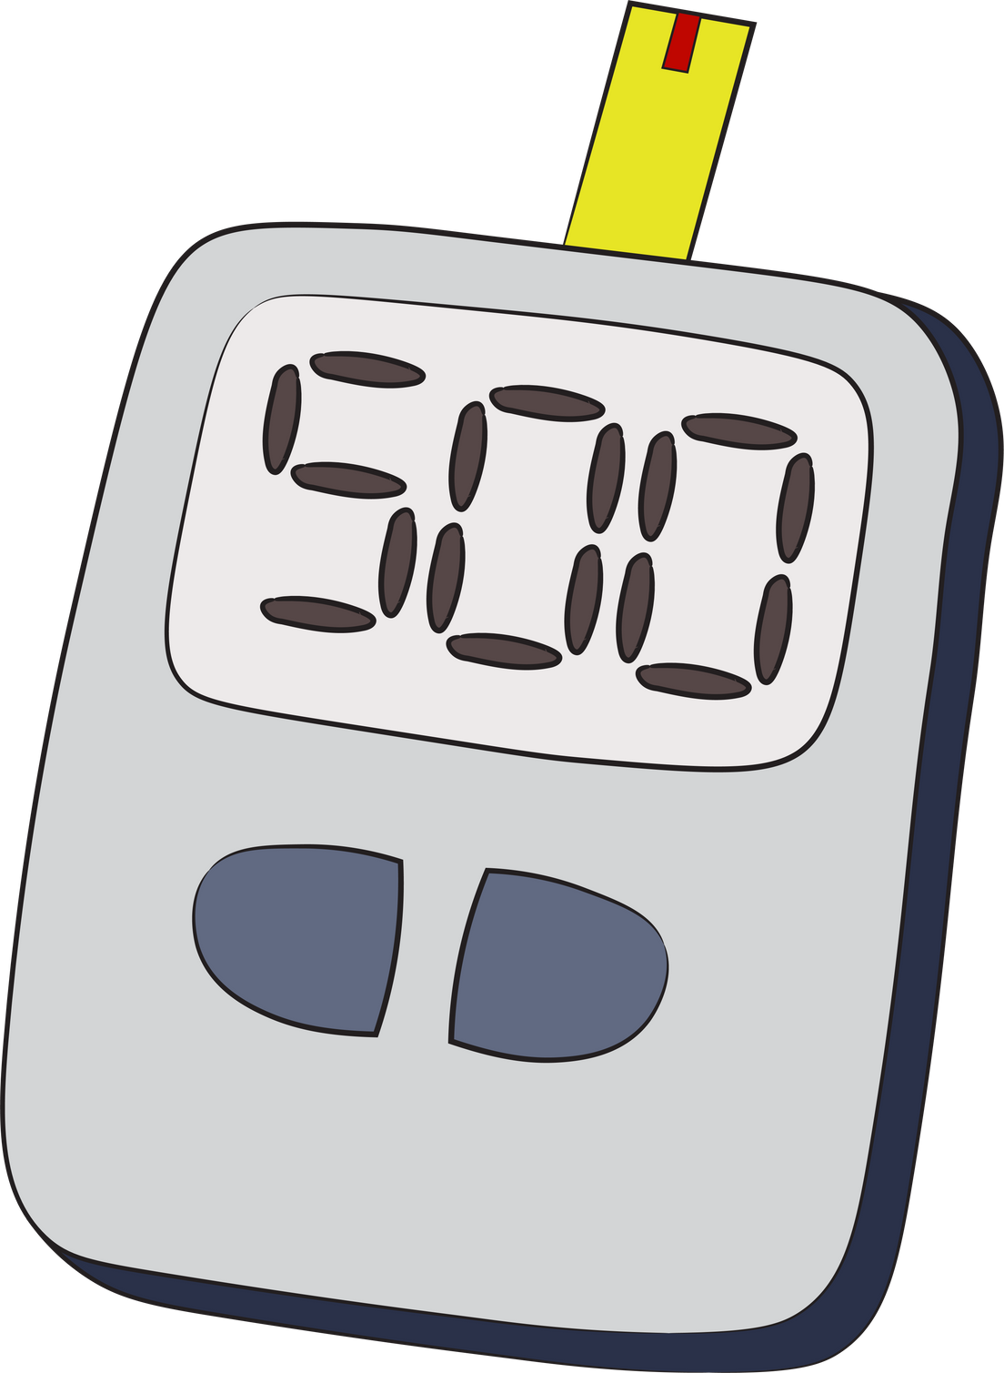
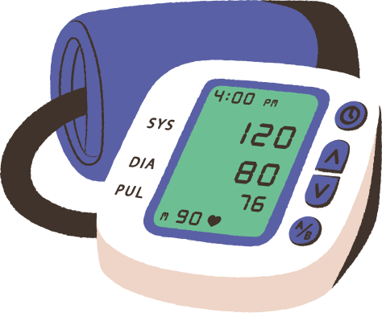
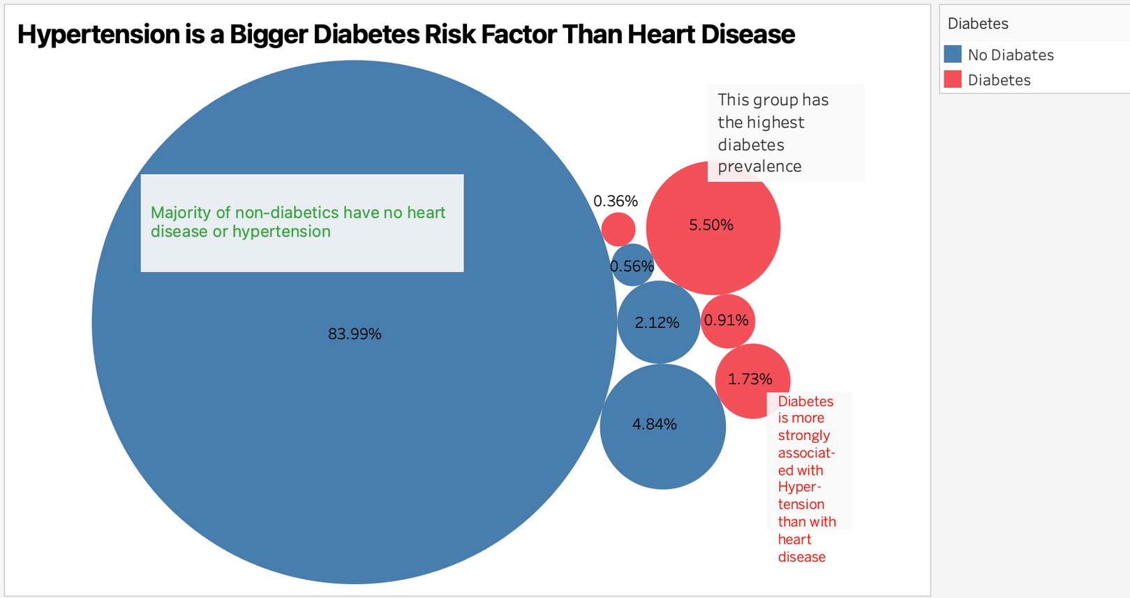
Diabetes, Heart Disease & Hypertension – Are They Connected?
83.99% of Non-Diabetics Have No Heart Disease or Hypertension
The Highest Diabetes Prevalence (5.50%) is in Those Without Heart Disease or Hypertension
Hypertension is a Bigger Diabetes Risk Factor Than Heart Disease

Slide 10
Behind the Visual – Why, How & What We Discovered
WHY WE CHOSE THIS VISUAL?
A bubble chart shows proportions clearly
Size highlights group differences, color separates diabetics vs. non-diabetic
CHALLENGES WE FACED
Keeping labels clear without overcrowding
Choosing the best insights to highlight
ANSWERS KEY QUESTION
Is Diabetes More Common in People with Heart Disease or Hypertension?

Slide 11
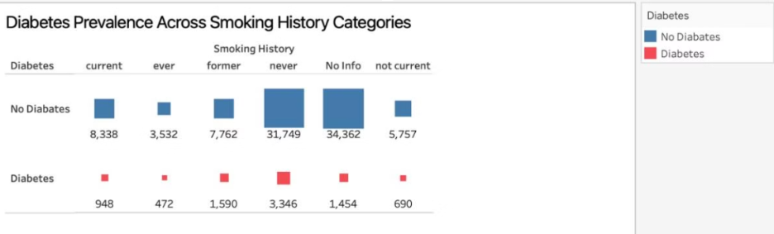
Most Diabetics Person Have Never Smoked- The Data Speaks!
Most Diabetics Have Never Smoked
Individuals With No Smoking Info Have the Highest Non-Diabetic Count – Lack of smoking history does not indicate a direct link to diabetes.

Slide 12
Behind the Visual – Why, How & What We Discovered
WHY WE CHOSE THIS VISUAL?
A TREE MAP IS IDEAL FOR UNDERSTANDING THE PROPORTIONS OF DIABETICS AND NON-DIABETICS IN EACH SMOKING CATEGORY. THE SQUARE SIZES ACCURATELY REFLECT THE DISTRIBUTION OF INDIVIDUALS WITHIN EACH GROUP.
CHALLENGES WE FACED
MISLEADING INTERPRETATION. THE CHART SUGGESTS THAT MOST DIABETICS HAVE NEVER SMOKED BUT THIS COULD BE DUE TO HIGHER NUMBER OF NON-SMOKERS IN DATASET.
ANSWERS KEY QUESTION
DOES SMOKING HISTORY IMPACT DIABETES RISK?

Slide 13
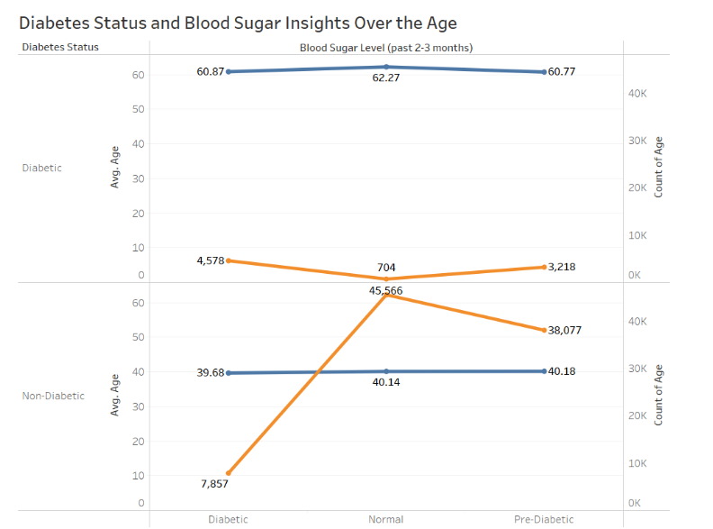
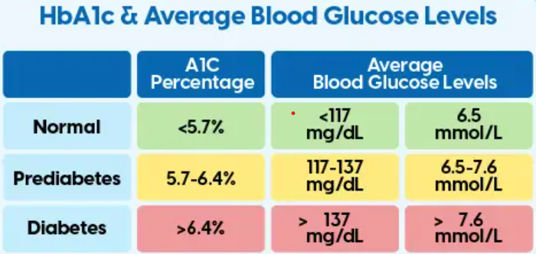
Impact of Age on Diabetes Status: Identifying Blood Sugar Levels
Trends showing how blood sugar changes with age or how diabetes prevalence changes by age groups.
At the age of 39-41 most of the patients are non-diabetic followed by pre-diabetic.
At the age of 60- 63 patients are diabetic.
We can observe that the count of patients aged 39 with high blood sugar levels is categorized as diabetic, but they were reported as non-diabetic (false negative).

Slide 14
Behind the Visual – Why, How & What We Discovered
WHY WE CHOSE THIS VISUAL?
EFFECTIVELY COMPARES KEY METRICS BETWEEN DIABETIC AND NON-DIABETIC INDIVIDUALS.
IT ALSO PROVIDES A CLEAR CLASSIFICATION OF DIABETES STATUS - FALSE POSITIVE AND FALSE NEGATIVE VALUES IN HBA1C TEST LEVEL
CHALLENGES WE FACED
DECIDING ON THE TYPE OF CHART TO USE.
UNDERSTANDING AND CATEGORIZING DIABETES STATUS USING HBA1C LEVEL
ANSWERS KEY QUESTION
WHICH AGE GROUPS HAVE A PREVALENCE TO DIABETES AND HOW HBA1C TEST DATA SUPPORTING THE INSIGHT.

Slide 15
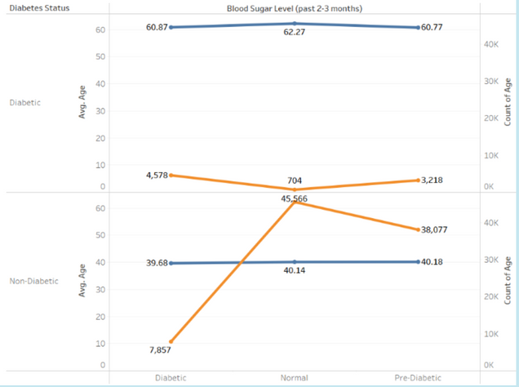
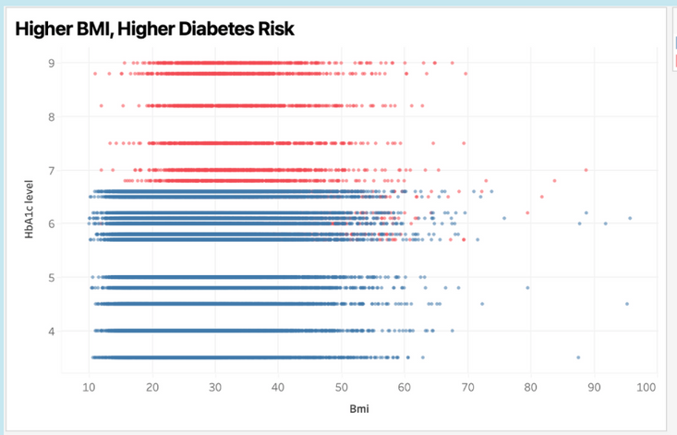
Diabetes Prevalence Peaks in Middle Age
Hypertension is a bigger risk factor than hear disease
Impact of Age on Diabetes Status
Higher BMI, Higher Diabetes Risk
Most Diabetics Person Have Never Smoked- The Data Speaks!

Slide 16
CONCLUSION- OUR DATA STORY
Our Visual Storytelling Journey
This project was not just about data but about how visualization helps uncover insights by creating impactful visualisations to answer key health-related questions.
Key Insights from Our Visualisations
Age & Diabetes: Middle-aged adults (40-59) have the highest diabetes prevalence.
BMI & Blood Sugar: Higher BMI and higher blood glucose may cause diabetes.
Smoking History & Diabetes: Most diabetics never smoked, challenging common assumptions.
Hypertension & Heart Disease: Hypertension is a bigger diabetes risk factor than heart disease.

Slide 17


